Slide 1
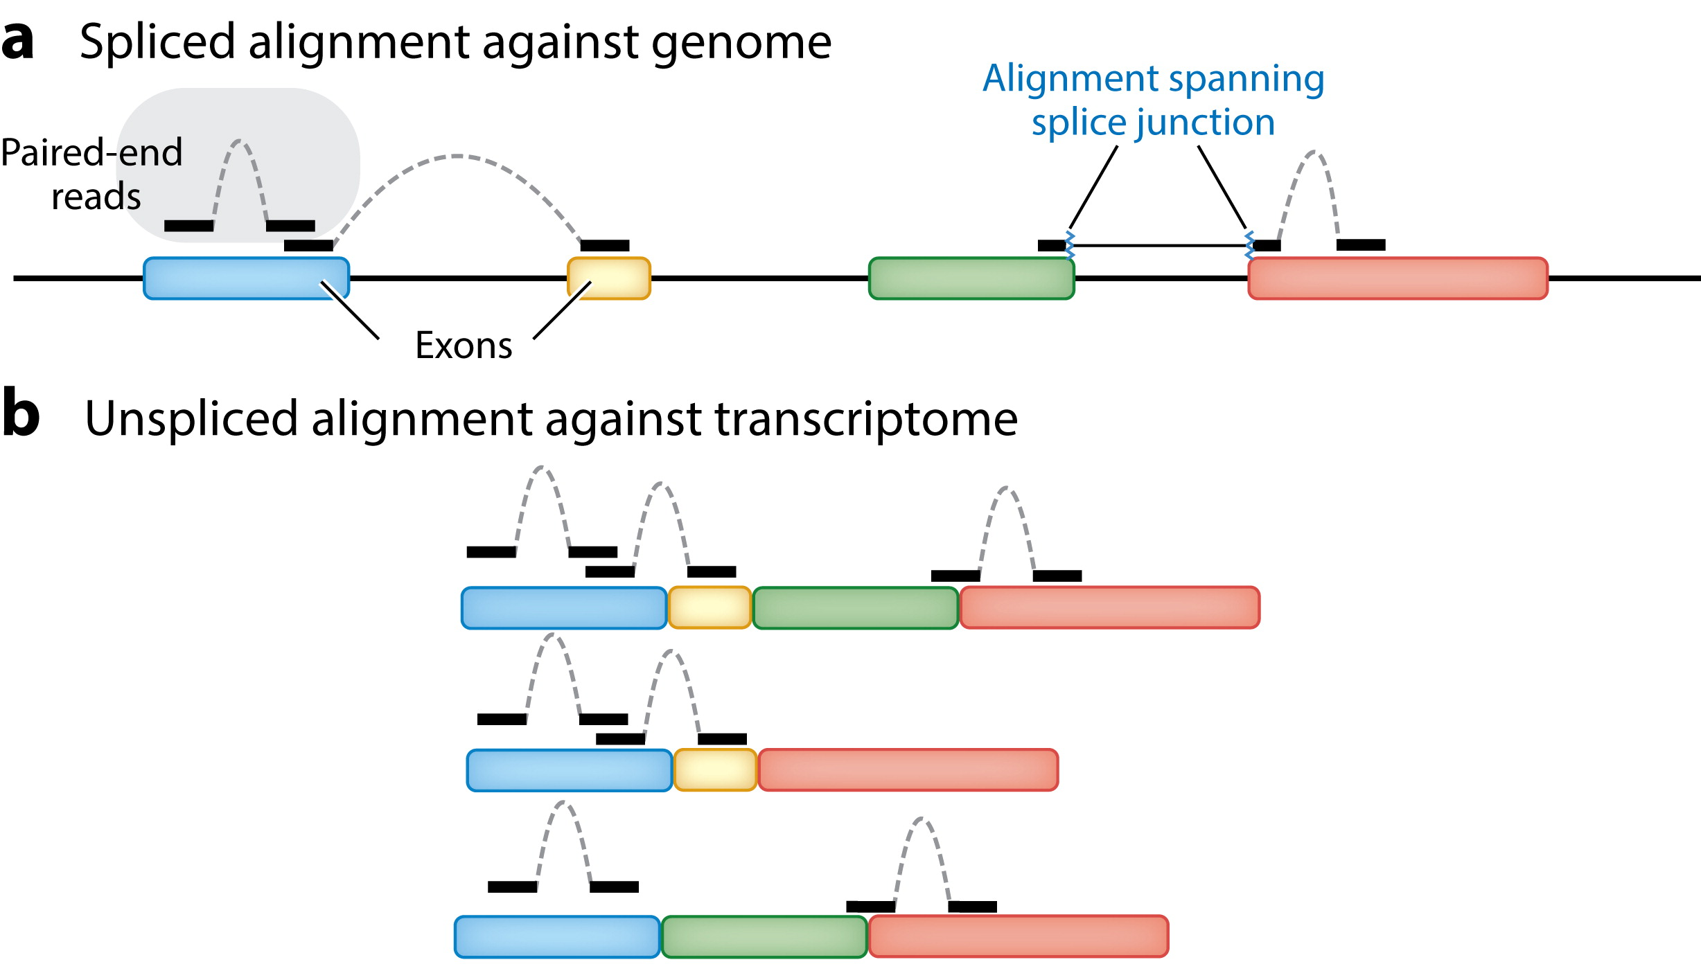

Slide 3
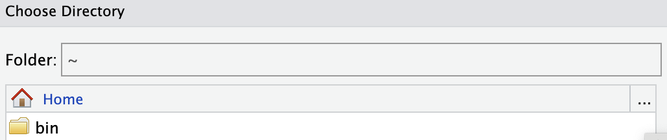

Slide 4
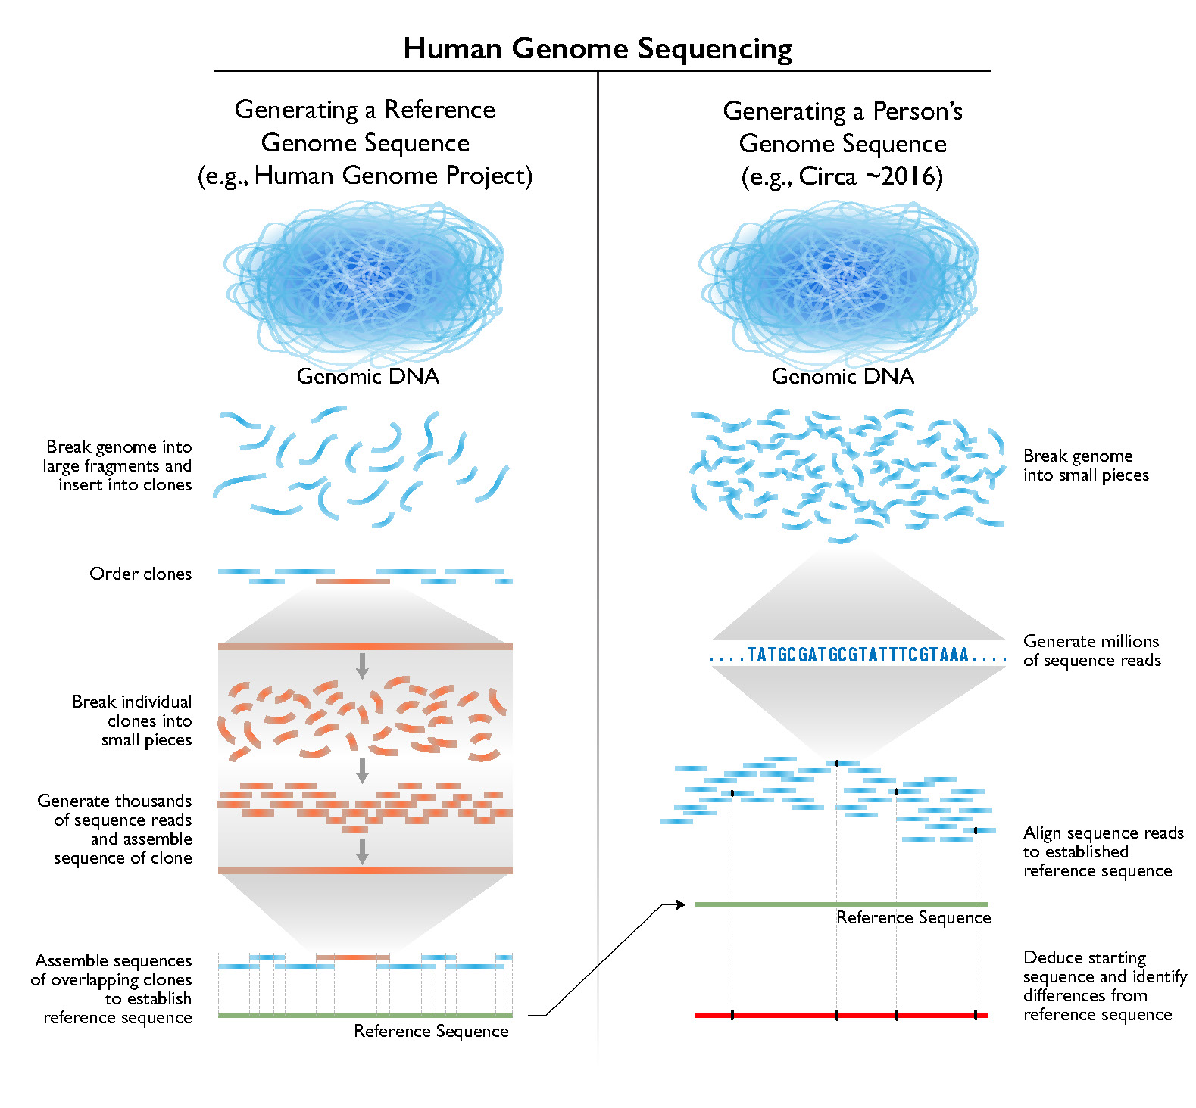

Slide 5
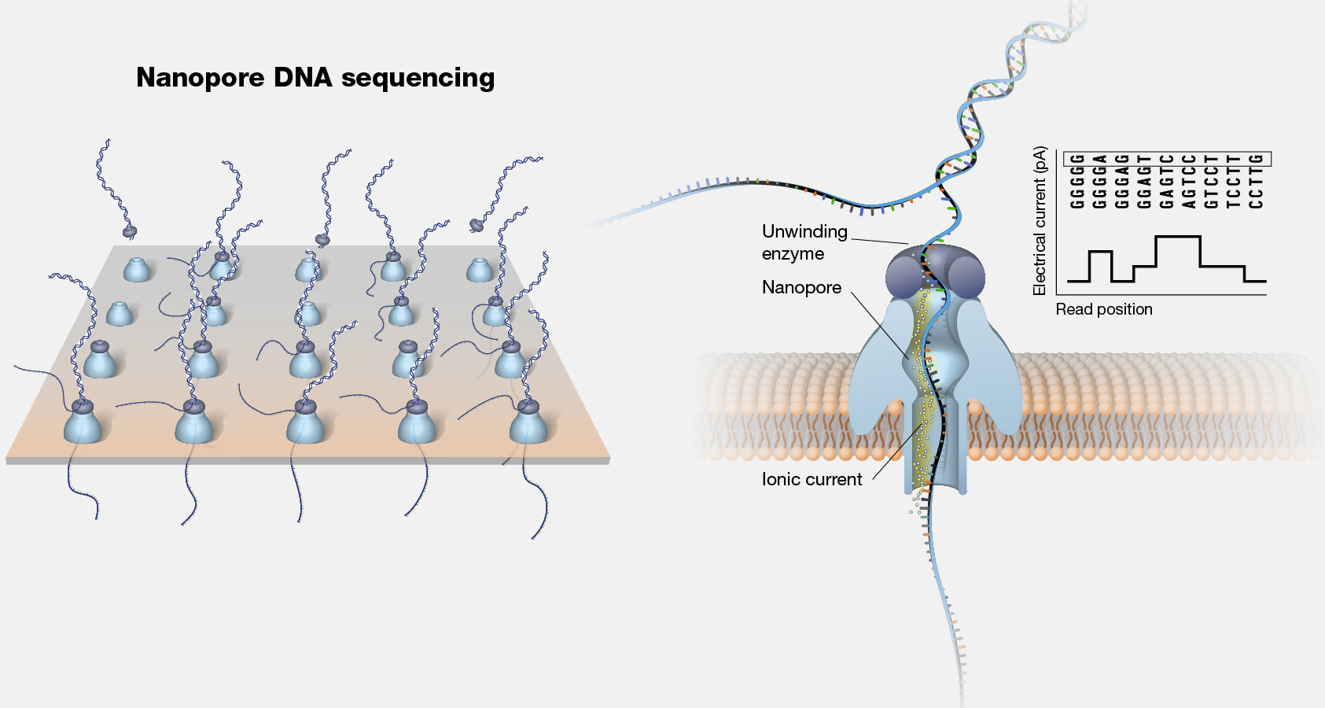

Slide 6
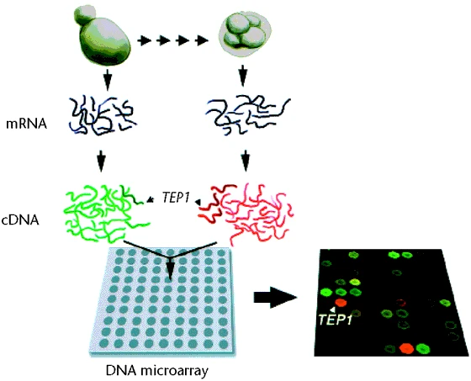

Slide 7
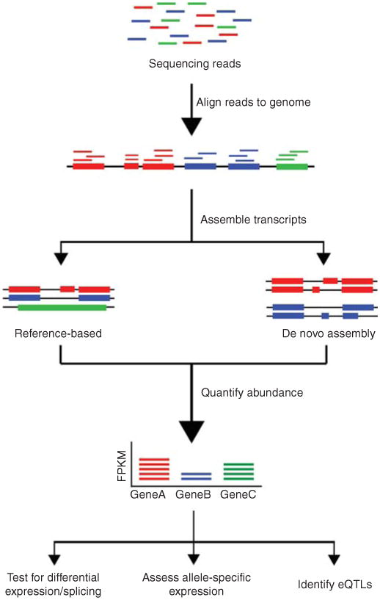

Slide 8

genome
transcriptome
proteome

Slide 9
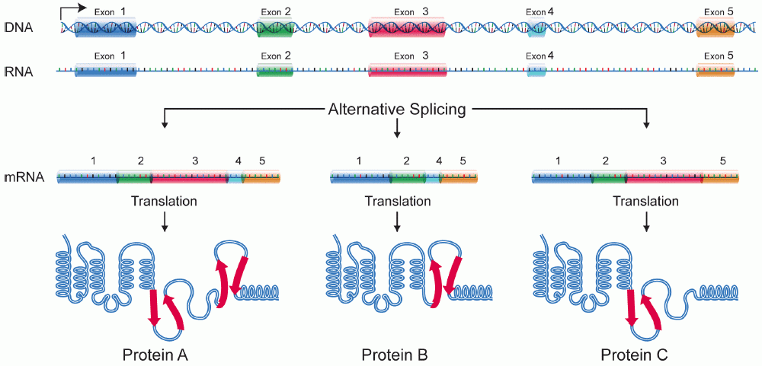
Transcription

Slide 10
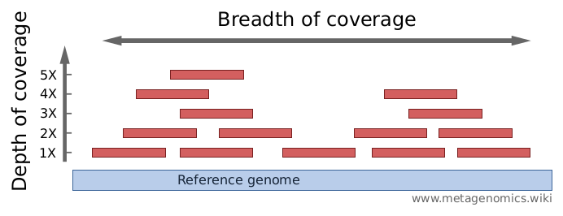

Slide 11
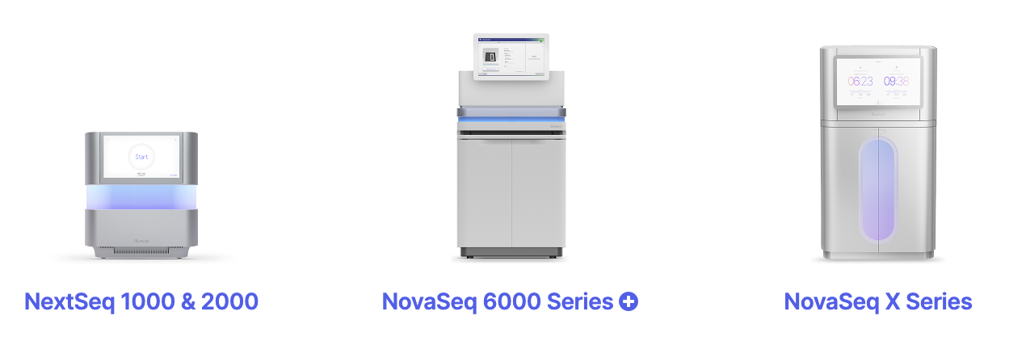
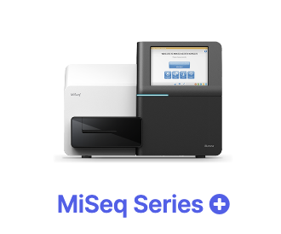
Max. output 15 Gb 360 Gb 6000 Gb 16 Tb
Max. # reads 25 M 1.2 B 20 B 52 B
Max. read length 300 bp 300 bp 250 bp 150 bp
Price per Gb $100-$200 $17-$60 $5-$30 $2-$3

Slide 12
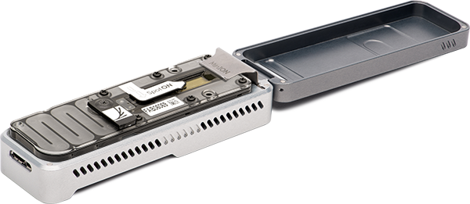
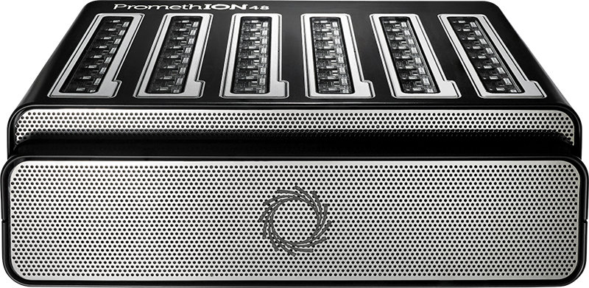
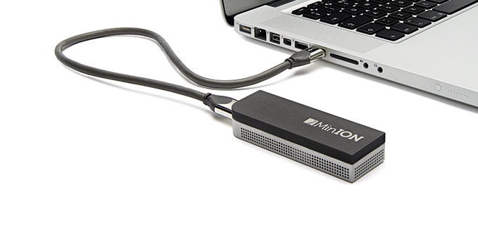
MinION ~15 Gb
PromethION ~90 Gb x 24/48 flowcells

Slide 13
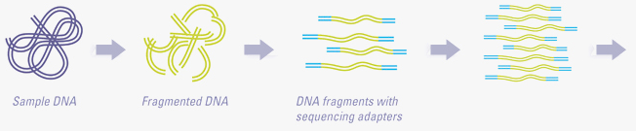
DNA fragmentation
Adapter addition
PCR enrichment
To sequencer

Slide 14
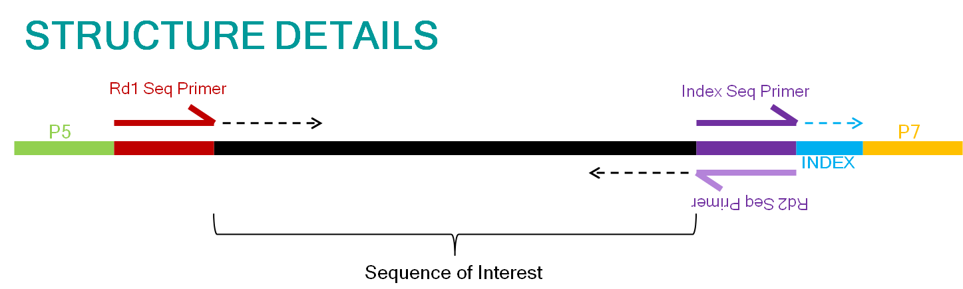
Adapter 1
DNA fragment
Adapter 2

Slide 15
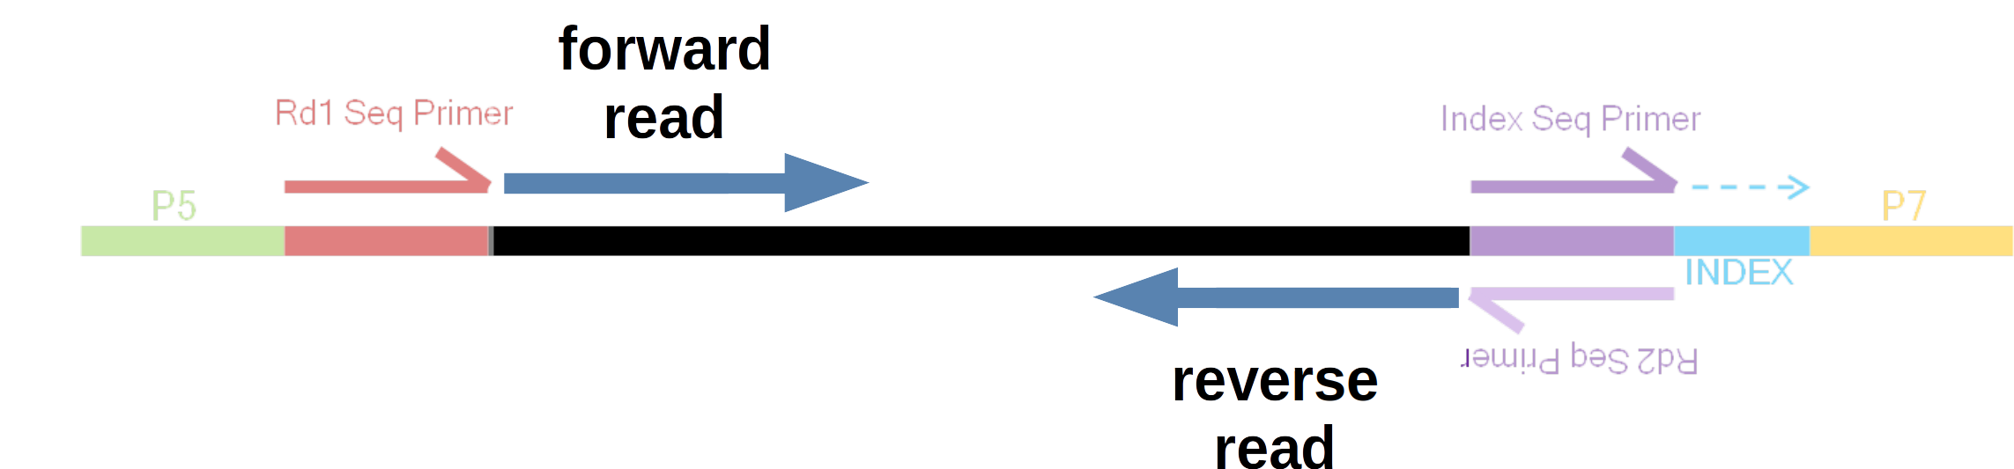
Adapter 1
DNA fragment
Adapter 2

Slide 16
forward read
reverse read
forward read
forward read
reverse read

Slide 17
forward read
reverse read
150 bp
100 bp
150 bp
Insert size: 400 bp
forward read
reverse read

Slide 18
forward read
reverse read

Slide 19
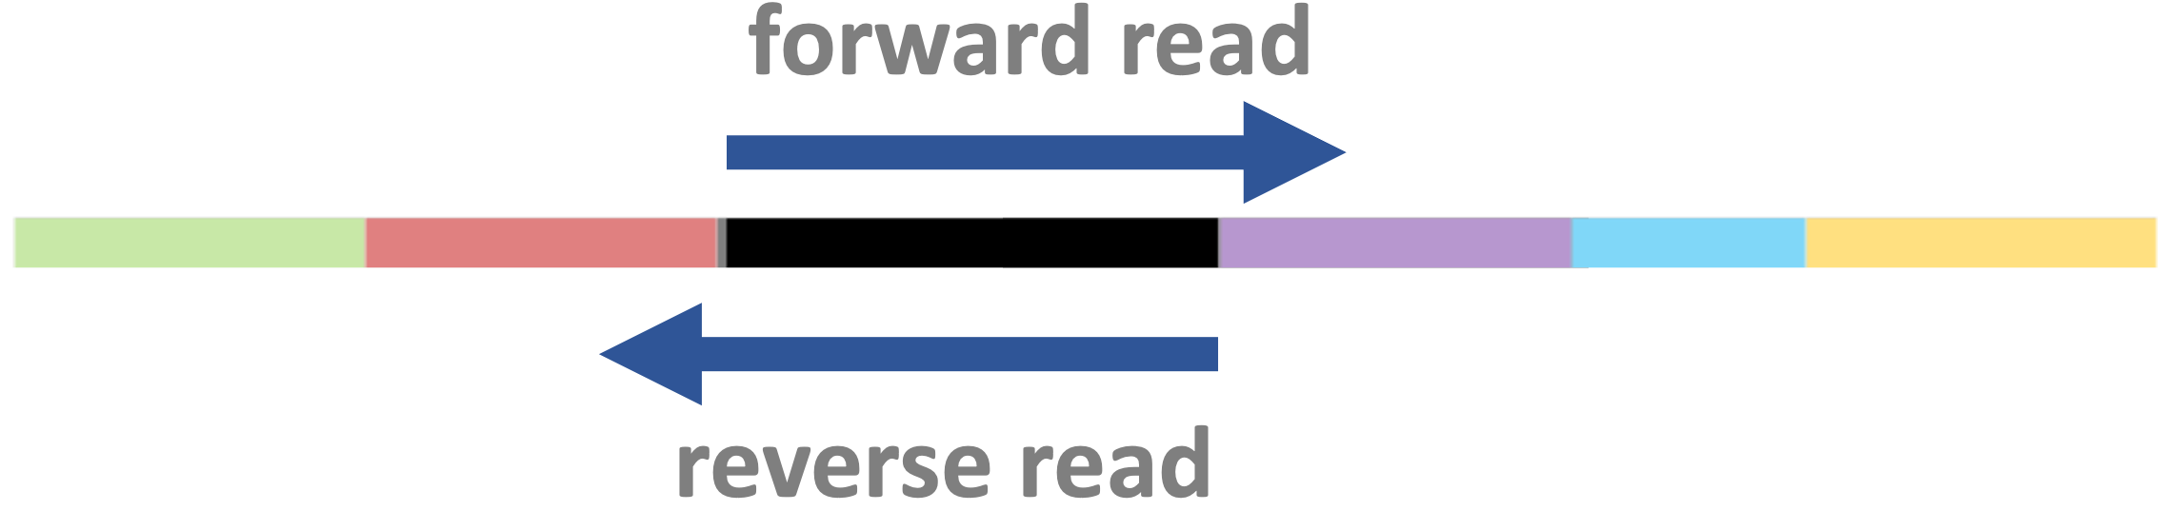


Slide 21
Indicate synthesis start site using sequencing primers
Binding to the flowcell
PCR amplification of fragments

Slide 22
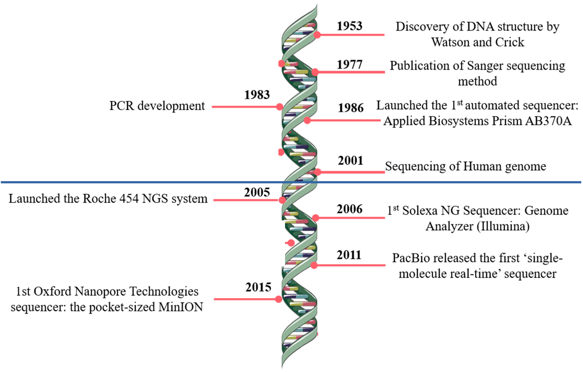

Slide 23
Indicate synthesis start site using sequencing primers
Allow for sample multiplexing using indices (barcodes)
Binding to the flowcell
PCR amplification of fragments

Slide 24
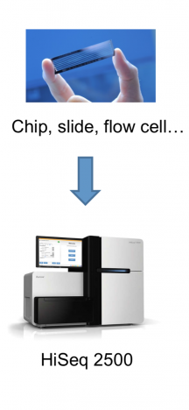

Slide 25
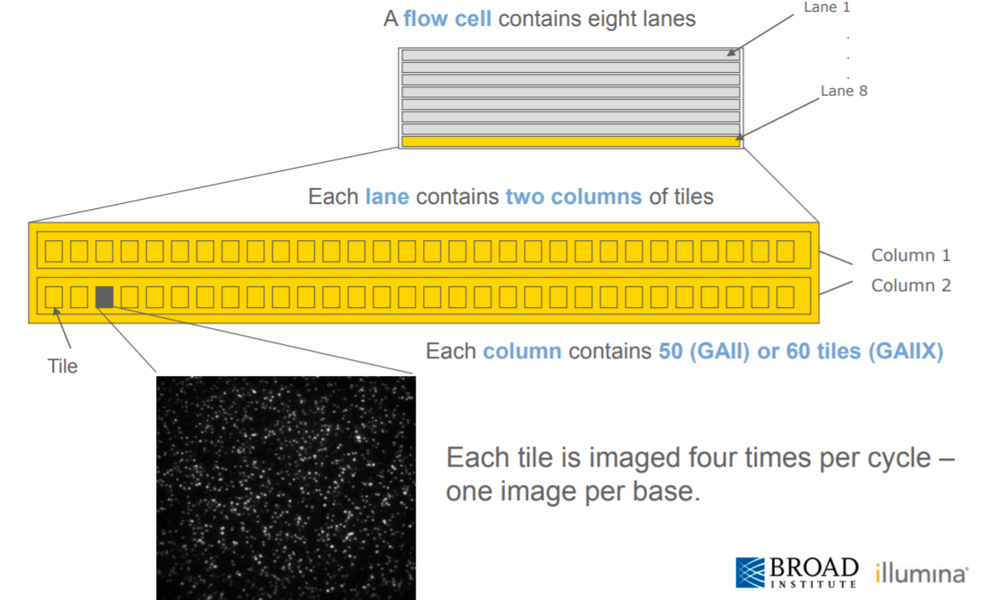
A flow cell contains multiple lanes
A lane contains multiple columns each with many tiles
Each speck in a tile is a cluster (!)

Slide 26
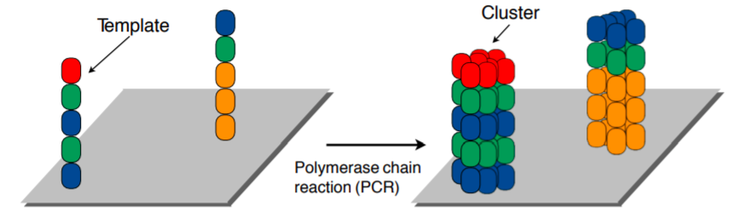
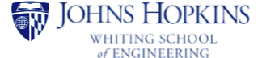

Slide 27
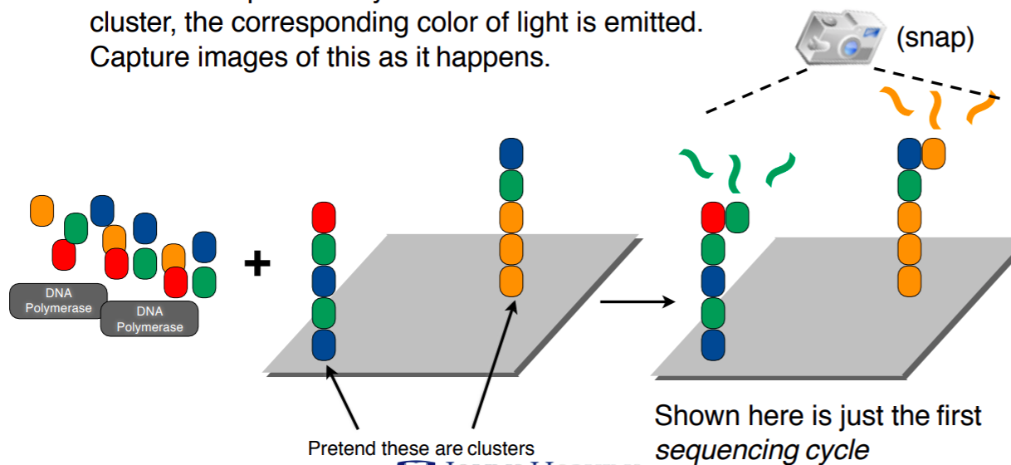
Add color-labeled nucleotides + DNA polymerase
When nucleotide is incorporated: light emitted & pictures taken

Slide 28
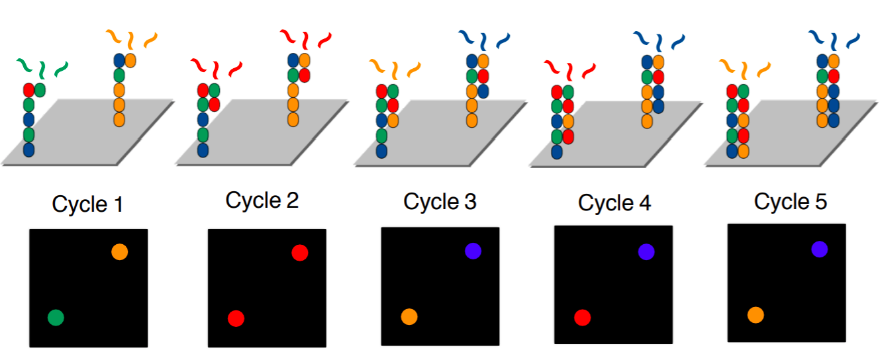
Terminators prevent continuous addition, hence “cycles”
- One cycle = one added nucleotide
- Read length = number of cycles

Slide 29
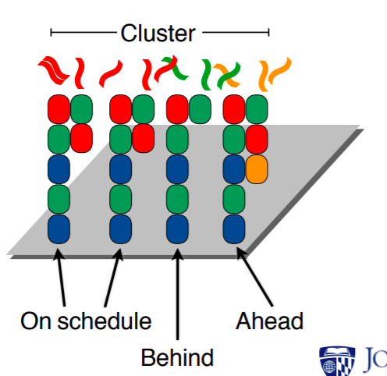

Slide 30
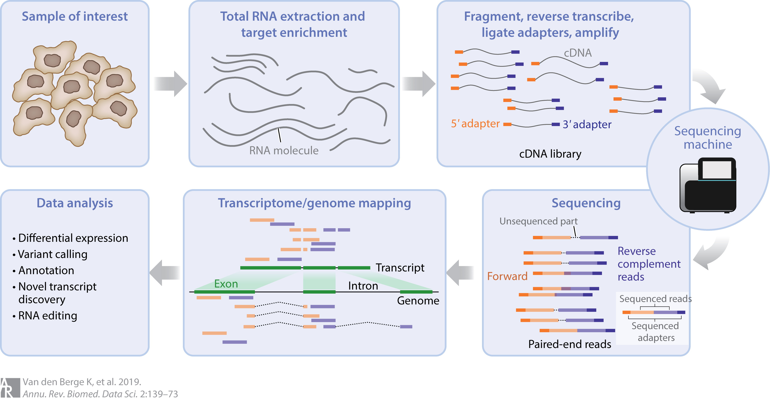

Slide 31
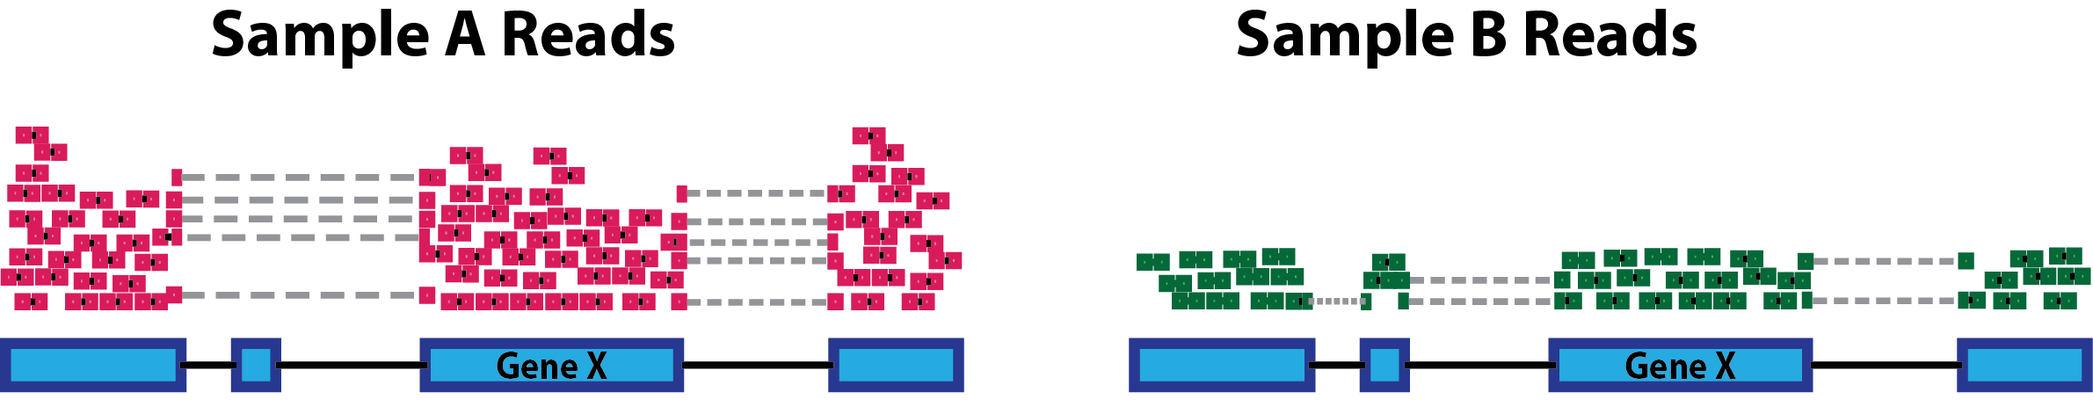

Slide 32
